Slide 1
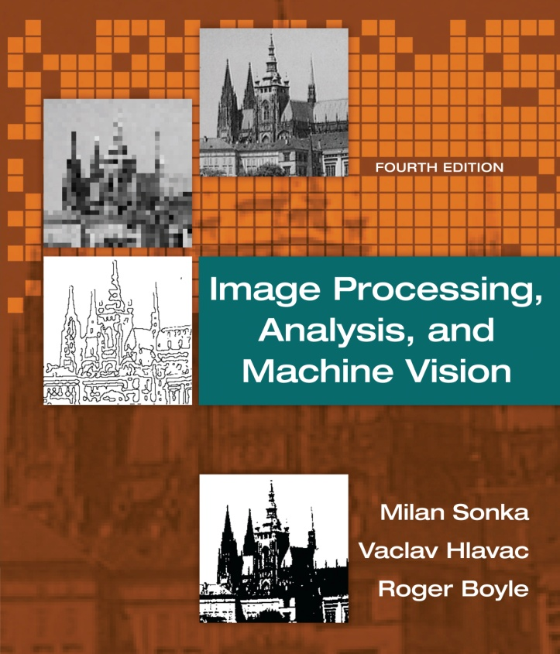

Chapter 5
Image Processing, Analysis, and Machine Vision, 4th Edition Sonka, Hlavac & Boyle
Image pre-processing

Slide 2
Image pre-processing
Image Processing, Analysis, and Machine Vision, 4th Edition Sonka, Hlavac & Boyle
Pixel brightness transformations
Geometric transformations
Local pre-processing
Image smoothing, edge detection, line detection, corner detection, and region detection.
Image restoration

Slide 3
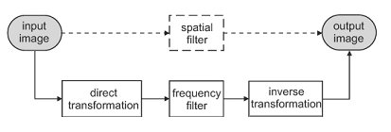
Introduction to linear integral transforms
Image Processing, Analysis, and Machine Vision, 4th Edition Sonka, Hlavac & Boyle
Image filtering (Chapter 3)
An application of a linear integral transform in image processing
Filtering can be performed in either spatial or frequency domains.
There is one-to-one mapping between the spatial and frequency domains.
For linear operations, these two ways should provide equivalent results.

Slide 4
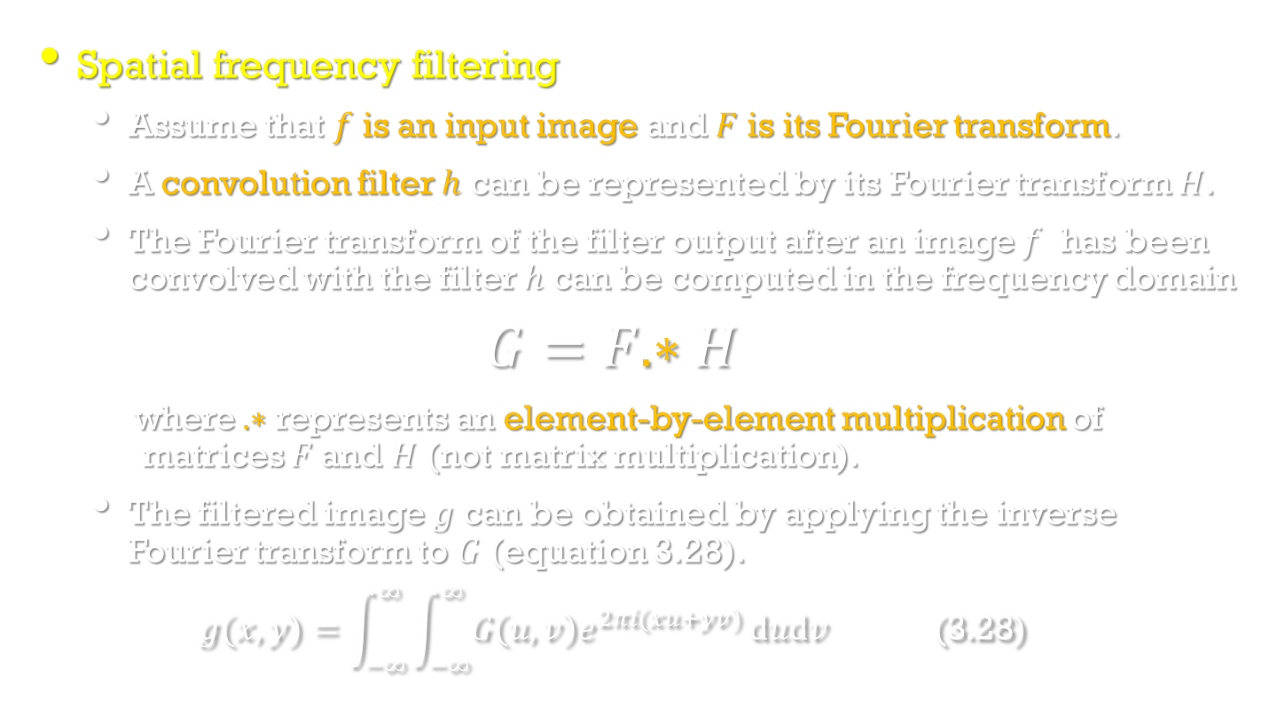
Local pre-processing in the frequency domain
Image Processing, Analysis, and Machine Vision, 4th Edition Sonka, Hlavac & Boyle
Spatial frequency filtering
Assume that $f$ is an input image and $F$ is its Fourier transform.
A convolution filter $h$ can be represented by its Fourier transform $H$.
The Fourier transform of the filter output after an image $f$ has been convolved with the filter $h$ can be computed in the frequency domain
$$G=F.∗H$$
where $.∗$ represents an element-by-element multiplication of matrices $F$and $H$ (not matrix multiplication).
The filtered image $g$ can be obtained by applying the inverse Fourier transform to $G$ (equation 3.28).
$$g(x,y)=\int_{−∞}^{∞}{\int_{−∞}^{∞}{G\left(u,v\right)e^{2πi(xu+yv)}}dudv \text{ (3.28)}}$$

Slide 5
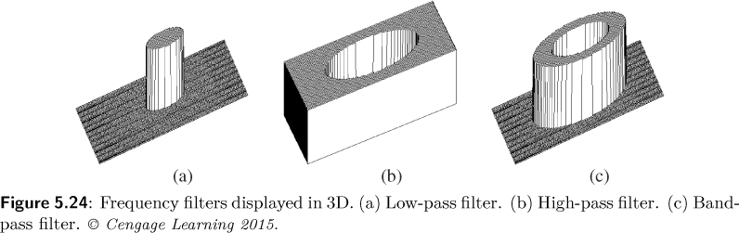
Local pre-processing in the frequency domain
Image Processing, Analysis, and Machine Vision, 4th Edition Sonka, Hlavac & Boyle
Some basic examples of spatial frequency filtering
Linear low-pass frequency filters
Linear high-pass frequency filters
Linear band-pass frequency filters
(http://www.ejectamenta.com/Imaging-Experiments/fourierimagefiltering.html)

Slide 6
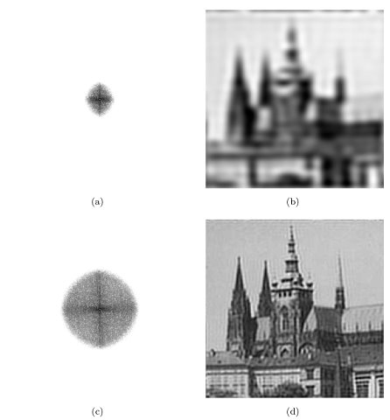
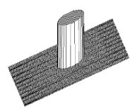
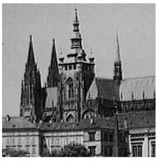
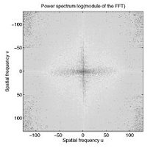
Local pre-processing in the frequency domain
Image Processing, Analysis, and Machine Vision, 4th Edition Sonka, Hlavac & Boyle
Low-pass frequency-domain filtering
Noise can be suppressed.
A blurred image

Slide 7
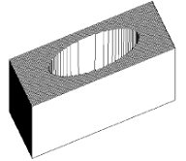
Local pre-processing in the frequency domain
Image Processing, Analysis, and Machine Vision, 4th Edition Sonka, Hlavac & Boyle
High-pass frequency-domain filtering
Edge can be enhanced.

Slide 8
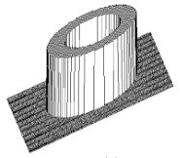
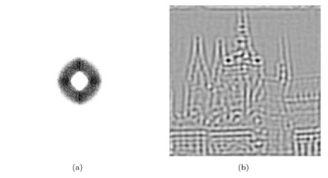
Local pre-processing in the frequency domain
Image Processing, Analysis, and Machine Vision, 4th Edition Sonka, Hlavac & Boyle
Bend-pass frequency-domain filtering

Slide 9
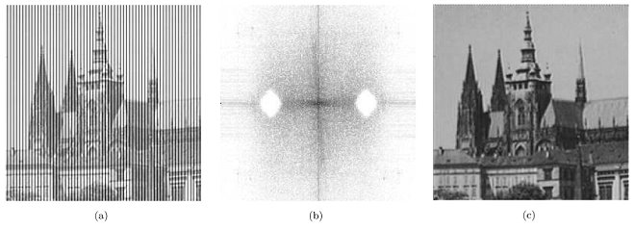
Local pre-processing in the frequency domain
Image Processing, Analysis, and Machine Vision, 4th Edition Sonka, Hlavac & Boyle
Periodic noise removal
(a) Noisy image
(b) Image spectrum used for image reconstruction
The areas of frequencies corresponding with periodic vertical lines are filtered out.
(c) Filtered image

Slide 10
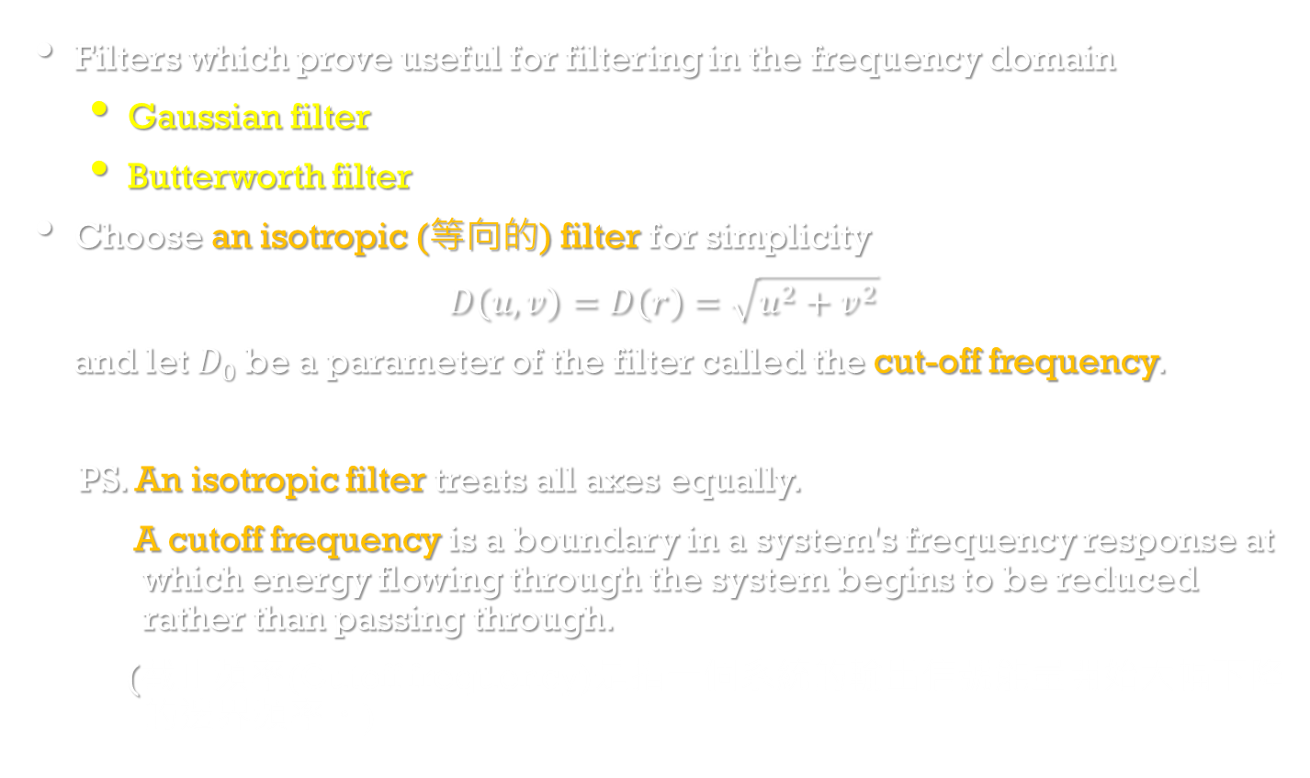
Local pre-processing in the frequency domain
Image Processing, Analysis, and Machine Vision, 4th Edition Sonka, Hlavac & Boyle
Filters which prove useful for filtering in the frequency domain
Gaussian filter
Butterworth filter
Choose an isotropic (等向的) filter for simplicity
$$D\left(u,v\right)=D\left(r\right)=\sqrt{u^{2}+v^{2}}$$
and let $D_{0}$ be a parameter of the filter called the cut-off frequency.
PS. An isotropic filter treats all axes equally.
A cutoff frequency is a boundary in a system's frequency response at which energy flowing through the system begins to be reduced rather than passing through.
(截止頻率(Cutoff frequency)是指一個系統的輸出信號能量開始大幅下降的邊界頻率。)

Slide 11
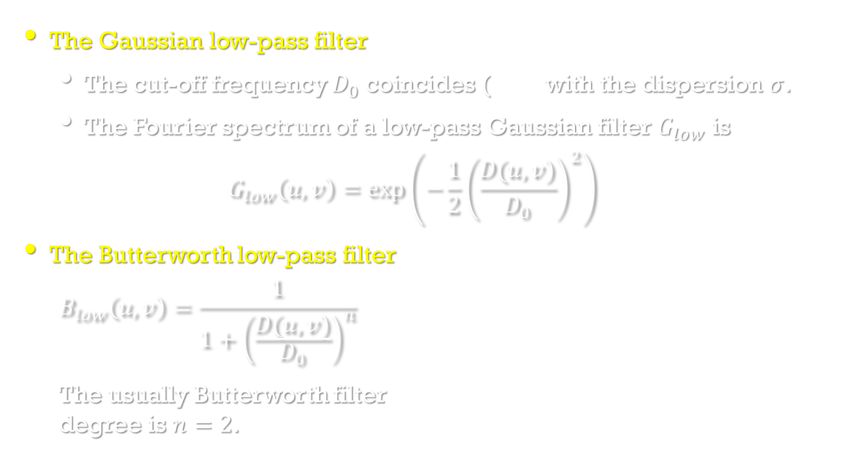

Local pre-processing in the frequency domain
Image Processing, Analysis, and Machine Vision, 4th Edition Sonka, Hlavac & Boyle
The Gaussian low-pass filter
The cut-off frequency $D_{0}$ coincides (一致) with the dispersion $σ$.
The Fourier spectrum of a low-pass Gaussian filter $G_{low}$ is
$$G_{low}\left(u,v\right)=exp⁡\left(−\frac{1}{2}{\left(\frac{D(u,v)}{D_{0}}\right)}^{2}\right)$$
The Butterworth low-pass filter
$$B_{low}\left(u,v\right)=\frac{1}{1+{\left(\frac{D(u,v)}{D_{0}}\right)}^{n}}$$
The usually Butterworth filter degree is $n=2$.
$$D_{0}=3$$

Slide 12
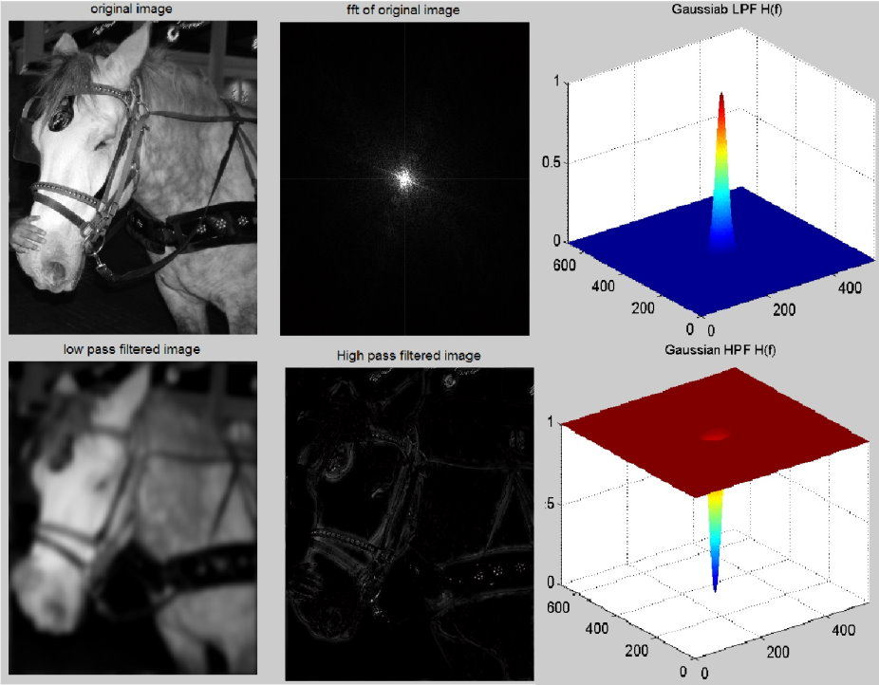
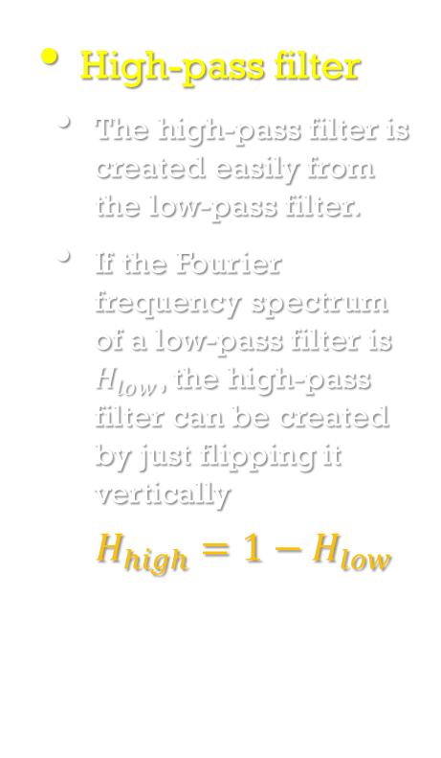
Local pre-processing in the frequency domain
Image Processing, Analysis, and Machine Vision, 4th Edition Sonka, Hlavac & Boyle
High-pass filter
The high-pass filter is created easily from the low-pass filter.
If the Fourier frequency spectrum of a low-pass filter is $H_{low}$, the high-pass filter can be created by just flipping it vertically
$$H_{high}=1−H_{low}$$
https://www.mathworks.com/matlabcentral/mlc-downloads/downloads/submissions/46812/versions/1/screenshot.jpg

Slide 13
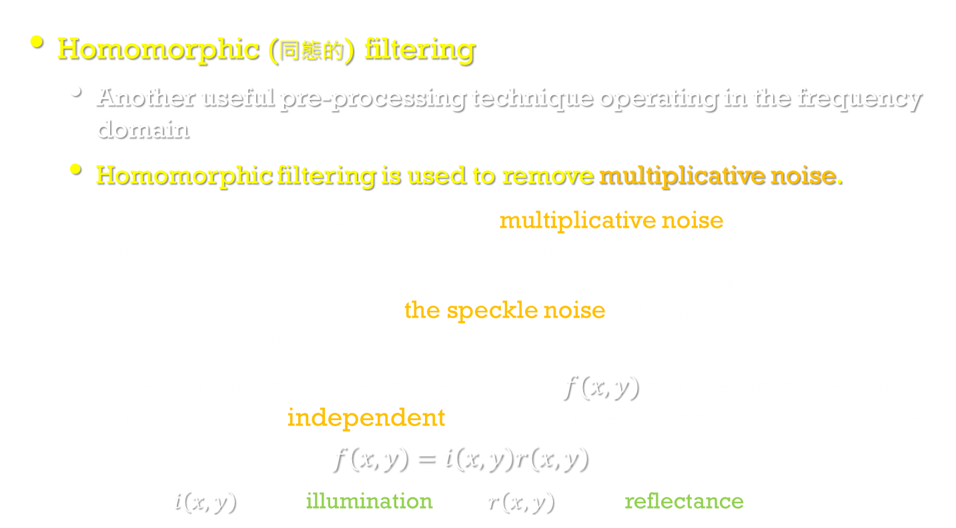
Local pre-processing in the frequency domain
Image Processing, Analysis, and Machine Vision, 4th Edition Sonka, Hlavac & Boyle
Homomorphic (同態的) filtering
Another useful pre-processing technique operating in the frequency domain
Homomorphic filtering is used to remove multiplicative noise.
PS: In signal processing, the term multiplicative noise (乘性雜訊) refers to an unwanted random signal that gets multiplied into some relevant signal during capture, transmission, or other processing. An important example is the speckle noise (斑點雜訊) commonly observed in radar imagery.
The assumption is the image function $f(x,y)$ can be factorized as a product of two independent multiplicative components in each pixel.
$$f\left(x,y\right)=i\left(x,y\right)r\left(x,y\right)$$
where $i\left(x,y\right)$ is the illumination and $r\left(x,y\right)$ is the reflectance

Slide 14
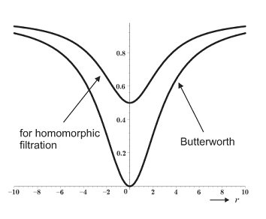
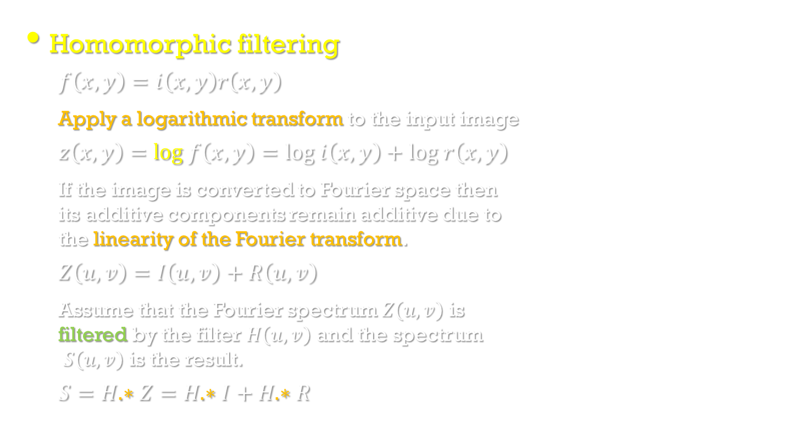
Local pre-processing in the frequency domain
Image Processing, Analysis, and Machine Vision, 4th Edition Sonka, Hlavac & Boyle
Homomorphic filtering
$$f\left(x,y\right)=i\left(x,y\right)r\left(x,y\right)$$
Apply a logarithmic transform to the input image
$$z\left(x,y\right)=log f\left(x,y\right)=log i\left(x,y\right)+log r\left(x,y\right)$$
If the image is converted to Fourier space then its additive components remain additive due to the linearity of the Fourier transform.
$$Z\left(u,v\right)=I\left(u,v\right)+R\left(u,v\right)$$
Assume that the Fourier spectrum $Z\left(u,v\right)$ is filtered by the filter $H\left(u,v\right)$ and the spectrum $S\left(u,v\right)$ is the result.
$$S=H.∗Z=H.∗I+H.∗R$$
We use a high-pass filter in the log domain to remove the low-frequency illumination component while preserving the high-frequency reflectance component.
http://blogs.mathworks.com/steve/2013/06/25/homomorphic-filtering-part-1/
Homomorphic filtering
https://zh.wikipedia.org/wiki/%E5%90%8C%E6%85%8B%E6%BF%BE%E6%B3%A2

Slide 15
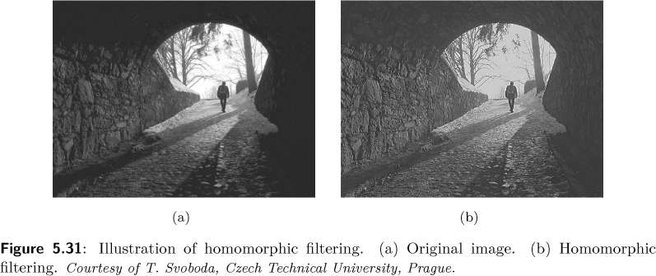
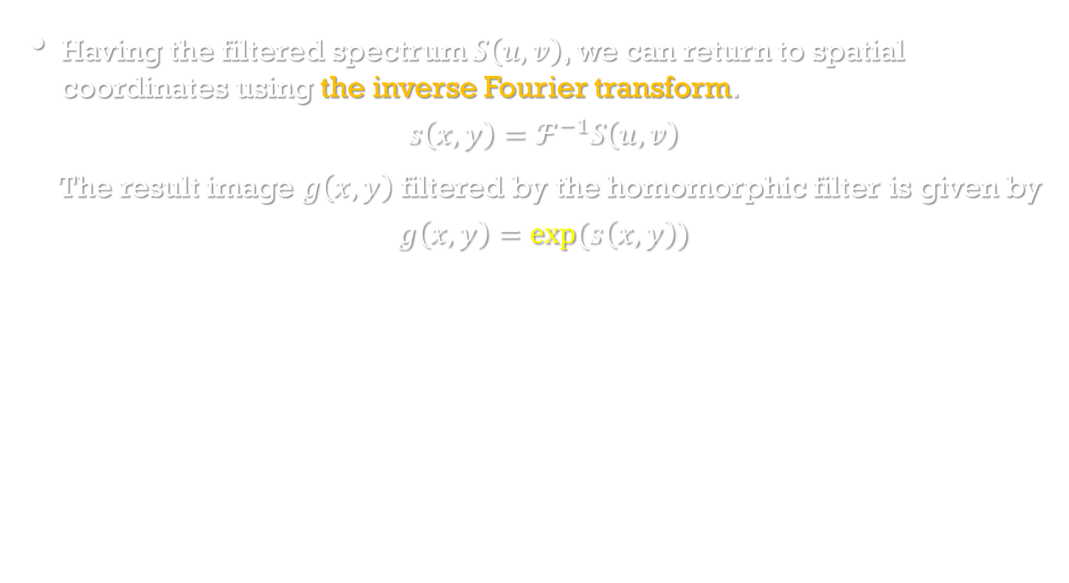
Homomorphic filtering
Image Processing, Analysis, and Machine Vision, 4th Edition Sonka, Hlavac & Boyle
Having the filtered spectrum $S\left(u,v\right)$, we can return to spatial coordinates using the inverse Fourier transform.
$$s\left(x,y\right)=ℱ^{−1}S\left(u,v\right)$$
The result image $g\left(x,y\right)$ filtered by the homomorphic filter is given by
$$g\left(x,y\right)=exp⁡(s\left(x,y\right))$$

Slide 16
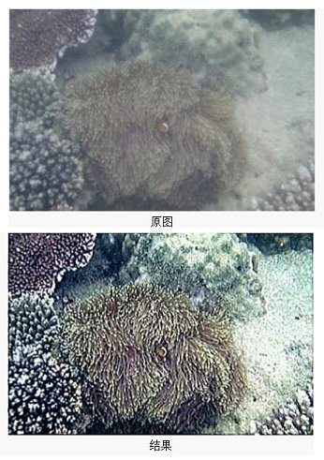
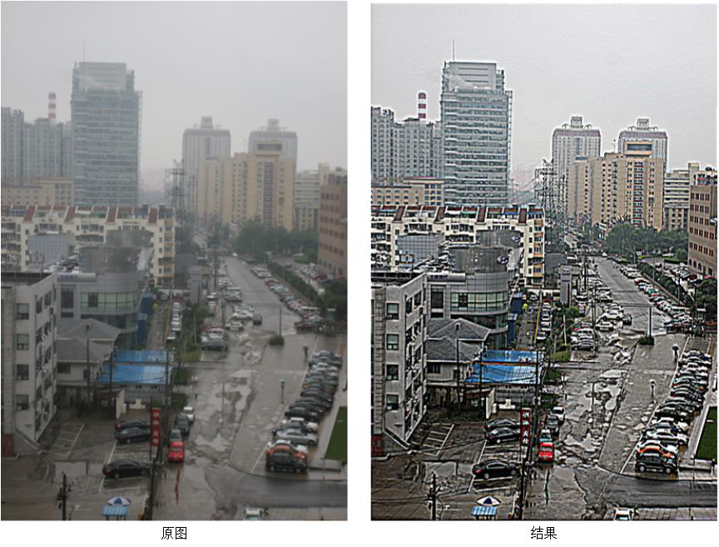
Homomorphic filtering
1. 一張影像可以表示為照度(illumination)分量和反射(reflectance)分量的乘積。 在時域上這兩者不可分離，但是經傅立葉轉換後在頻域中則可以線性分離。
2. 由於照度變化較小，可以視為影像低頻成份；而反射相對變化較大，可視為高頻成份。
https://zh.wikipedia.org/wiki/%E5%90%8C%E6%85%8B%E6%BF%BE%E6%B3%A2
http://blog.csdn.net/bluecol/article/details/45788803

Slide 17
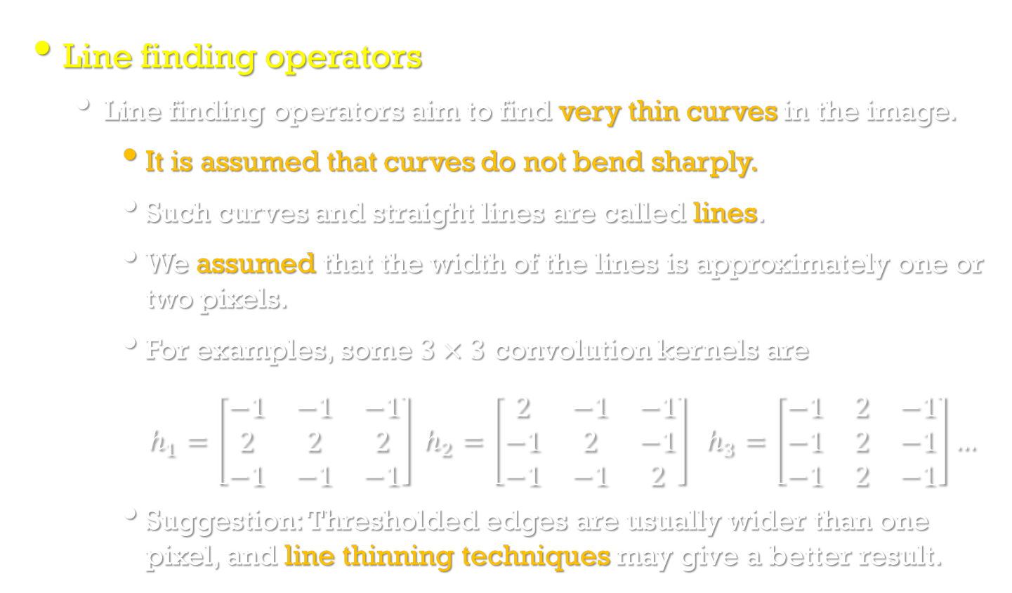
Line detection by local pre-processing operators
Image Processing, Analysis, and Machine Vision, 4th Edition Sonka, Hlavac & Boyle
Line finding operators
Line finding operators aim to find very thin curves in the image.
It is assumed that curves do not bend sharply.
Such curves and straight lines are called lines.
We assumed that the width of the lines is approximately one or two pixels.
For examples, some $3×3$ convolution kernels are
$h_{1}=\left[\begin{matrix}−1 & −1 & −1 \\ 2 & 2 & 2 \\ −1 & −1 & −1\end{matrix}\right] h_{2}=\left[\begin{matrix}2 & −1 & −1 \\ −1 & 2 & −1 \\ −1 & −1 & 2\end{matrix}\right] h_{3}=\left[\begin{matrix}−1 & 2 & −1 \\ −1 & 2 & −1 \\ −1 & 2 & −1\end{matrix}\right]…$
Suggestion: Thresholded edges are usually wider than one pixel, and line thinning techniques may give a better result.

Slide 18
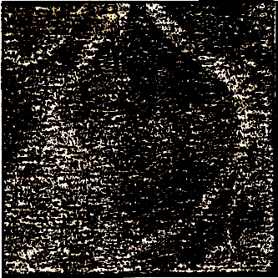
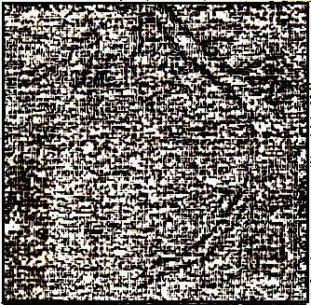
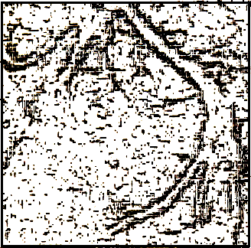
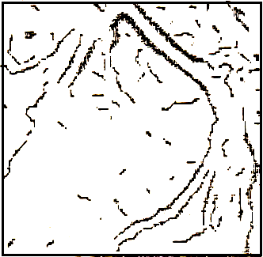
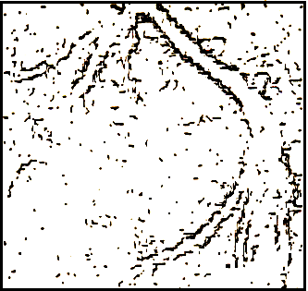
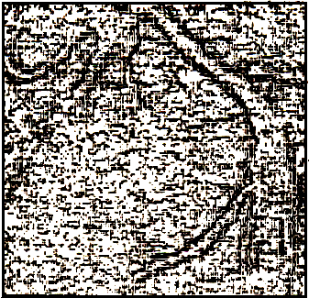
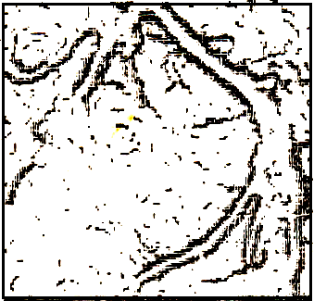
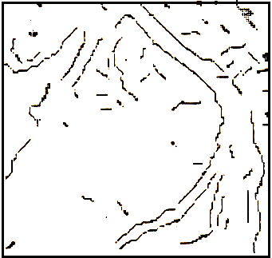
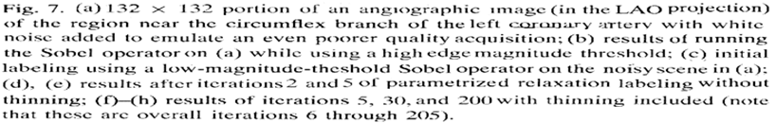
Edge Reinforcement with Thinning
(a) (c) (e) (g)
(b) (d) (f) (h)

Slide 19
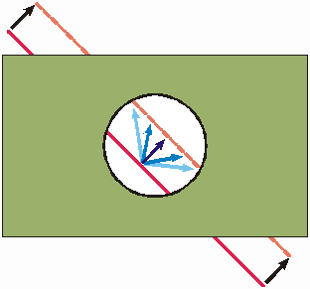
Detection of corners
Image Processing, Analysis, and Machine Vision, 4th Edition Sonka, Hlavac & Boyle
Corners
One kind of interest points for the correspondence problem.
Corners in images can be located using local detector.
Interest points are obtained by thresholding the result of the corner detector.
Corners serves better than lines when the correspondence problem is to be solved.
Why?
The aperture problem. (孔徑問題)

Slide 20
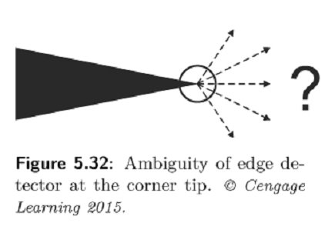
Detection of corners
Image Processing, Analysis, and Machine Vision, 4th Edition Sonka, Hlavac & Boyle
Corners
Edge detectors themselves are not stable at corner.
This is natural as the gradient at the tip of the corner is ambiguous.
Figure 5.32 shows a sharp corner.
Near the corner there is a discontinuity in the gradient direction, and this observation is used in corner detectors.

Slide 21
Detection of corners
Image Processing, Analysis, and Machine Vision, 4th Edition Sonka, Hlavac & Boyle
Corners
A corner in an image can be defined as a pixel in whose immediate neighborhood there are two dominant(明顯的), different edge directions.
Corner detectors are not usually very robust. One can detect corners using two or more images.
Corner detector
Moravce detector
Zuniga-Haralick operator
Harris corner detector

Slide 22
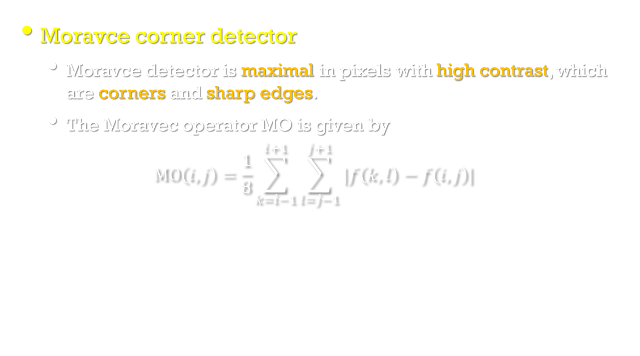
Detection of corners
Image Processing, Analysis, and Machine Vision, 4th Edition Sonka, Hlavac & Boyle
Moravce corner detector
Moravce detector is maximal in pixels with high contrast, which are corners and sharp edges.
The Moravec operator MO is given by
$$MO\left(i,j\right)=\frac{1}{8}\sum_{k=i−1}^{i+1}{\sum_{l=j−1}^{j+1}{|f\left(k,l\right)−f\left(i,j\right)|}}$$

Slide 23
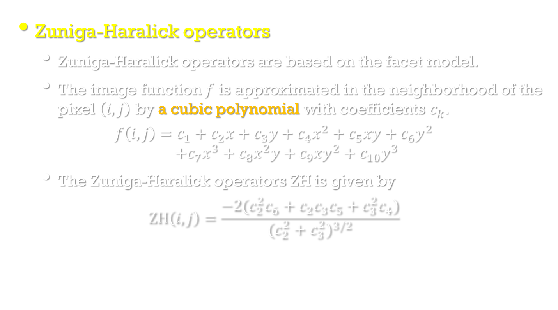
Detection of corners
Image Processing, Analysis, and Machine Vision, 4th Edition Sonka, Hlavac & Boyle
Zuniga-Haralick operators
Zuniga-Haralick operators are based on the facet model.
The image function $f$ is approximated in the neighborhood of the pixel $\left(i,j\right)$ by a cubic polynomial with coefficients $c_{k}$.
$$f\left(i,j\right)=c_{1}+c_{2}x+c_{3}y+c_{4}x^{2}+c_{5}xy+c_{6}y^{2} \\ +c_{7}x^{3}+c_{8}x^{2}y+c_{9}xy^{2}+c_{10}y^{3}$$
The Zuniga-Haralick operators ZH is given by
$$ZH\left(i,j\right)=\frac{−2(c_{2}^{2}c_{6}+c_{2}c_{3}c_{5}+c_{3}^{2}c_{4})}{{(c_{2}^{2}+c_{3}^{2})}^{3/2}}$$

Slide 24
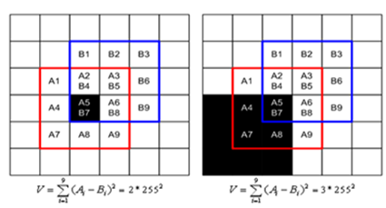
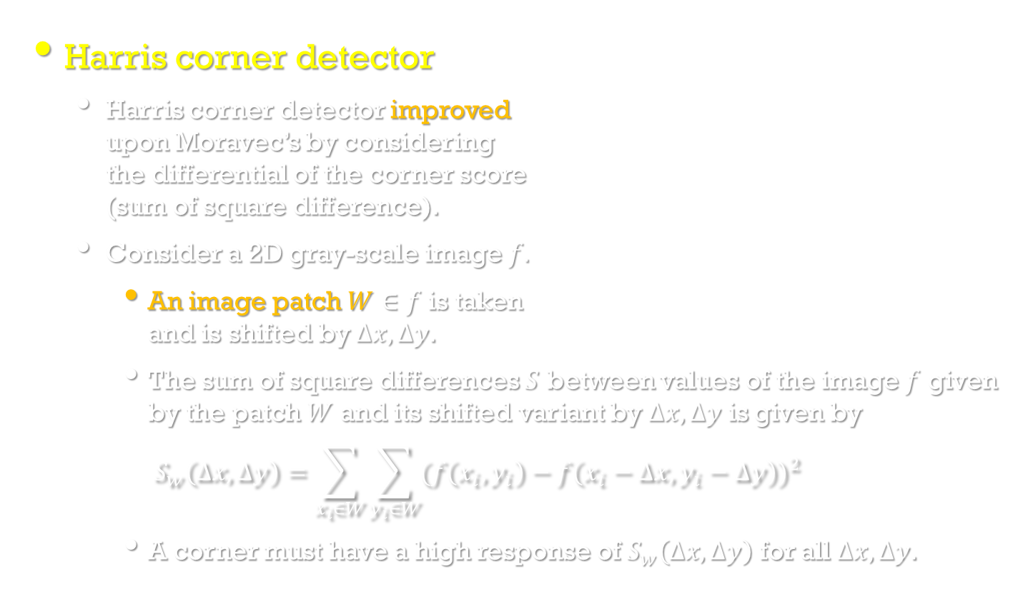
Detection of corners
Image Processing, Analysis, and Machine Vision, 4th Edition Sonka, Hlavac & Boyle
Harris corner detector
Harris corner detector improved upon Moravec’s by considering the differential of the corner score (sum of square difference).
Consider a 2D gray-scale image $f.$
An image patch $W∈f$ is taken and is shifted by $∆x,∆y$.
The sum of square differences $S$ between values of the image $f$ given by the patch $W$ and its shifted variant by $∆x,∆y$ is given by
$$S_{w}\left(∆x,∆y\right)=\sum_{x_{i}∈W}{\sum_{y_{i}∈W}{{(f\left(x_{i},y_{i}\right)−f\left(x_{i}−∆x,y_{i}−∆y\right))}^{2}}}$$
A corner must have a high response of $S_{w}\left(∆x,∆y\right)$ for all $∆x,∆y$.
http://blog.csdn.net/jwh_bupt/article/details/7628665

Slide 25
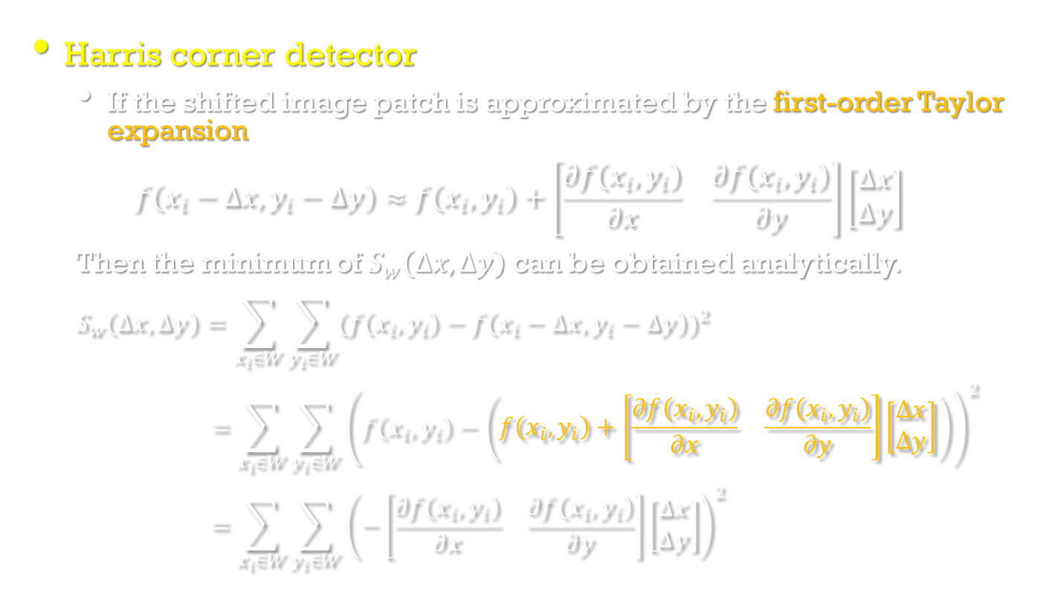
Detection of corners
Image Processing, Analysis, and Machine Vision, 4th Edition Sonka, Hlavac & Boyle
Harris corner detector
If the shifted image patch is approximated by the first-order Taylor expansion
$$f\left(x_{i}−∆x,y_{i}−∆y\right)≈f\left(x_{i},y_{i}\right)+\left[\begin{matrix}\frac{∂f\left(x_{i},y_{i}\right)}{∂x} & \frac{∂f\left(x_{i},y_{i}\right)}{∂y}\end{matrix}\right]\left[\begin{matrix}∆x \\ ∆y\end{matrix}\right]$$
Then the minimum of $S_{w}\left(∆x,∆y\right)$ can be obtained analytically.
$$S_{w}\left(∆x,∆y\right)=\sum_{x_{i}∈W}{\sum_{y_{i}∈W}{{(f\left(x_{i},y_{i}\right)−f\left(x_{i}−∆x,y_{i}−∆y\right))}^{2}}}$$
$$=\sum_{x_{i}∈W}{\sum_{y_{i}∈W}{{\left(f\left(x_{i},y_{i}\right)−\left(f\left(x_{i},y_{i}\right)+\left[\begin{matrix}\frac{∂f\left(x_{i},y_{i}\right)}{∂x} & \frac{∂f\left(x_{i},y_{i}\right)}{∂y}\end{matrix}\right]\left[\begin{matrix}∆x \\ ∆y\end{matrix}\right]\right)\right)}^{2}}}$$
$$=\sum_{x_{i}∈W}{\sum_{y_{i}∈W}{{\left(−\left[\begin{matrix}\frac{∂f\left(x_{i},y_{i}\right)}{∂x} & \frac{∂f\left(x_{i},y_{i}\right)}{∂y}\end{matrix}\right]\left[\begin{matrix}∆x \\ ∆y\end{matrix}\right]\right)}^{2}}}$$

Slide 26
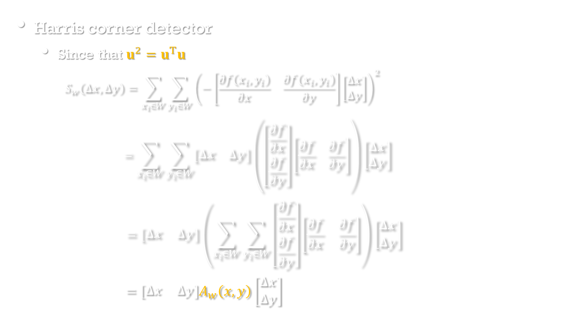
Detection of corners
Image Processing, Analysis, and Machine Vision, 4th Edition Sonka, Hlavac & Boyle
Harris corner detector
Since that $u^{2}=u^{T}u$
$$S_{w}\left(∆x,∆y\right)=\sum_{x_{i}∈W}{\sum_{y_{i}∈W}{{\left(−\left[\begin{matrix}\frac{∂f\left(x_{i},y_{i}\right)}{∂x} & \frac{∂f\left(x_{i},y_{i}\right)}{∂y}\end{matrix}\right]\left[\begin{matrix}∆x \\ ∆y\end{matrix}\right]\right)}^{2}}}$$
$$=\sum_{x_{i}∈W}{\sum_{y_{i}∈W}{\left[\begin{matrix}∆x & ∆y\end{matrix}\right]\left(\left[\begin{matrix}\frac{∂f}{∂x} \\ \frac{∂f}{∂y}\end{matrix}\right]\left[\begin{matrix}\frac{∂f}{∂x} & \frac{∂f}{∂y}\end{matrix}\right]\right)\left[\begin{matrix}∆x \\ ∆y\end{matrix}\right]}}$$
$$=\left[\begin{matrix}∆x & ∆y\end{matrix}\right]\left(\sum_{x_{i}∈W}{\sum_{y_{i}∈W}{\left[\begin{matrix}\frac{∂f}{∂x} \\ \frac{∂f}{∂y}\end{matrix}\right]\left[\begin{matrix}\frac{∂f}{∂x} & \frac{∂f}{∂y}\end{matrix}\right]}}\right)\left[\begin{matrix}∆x \\ ∆y\end{matrix}\right]$$
$$=\left[\begin{matrix}∆x & ∆y\end{matrix}\right]A_{w}\left(x,y\right)\left[\begin{matrix}∆x \\ ∆y\end{matrix}\right]$$

Slide 27
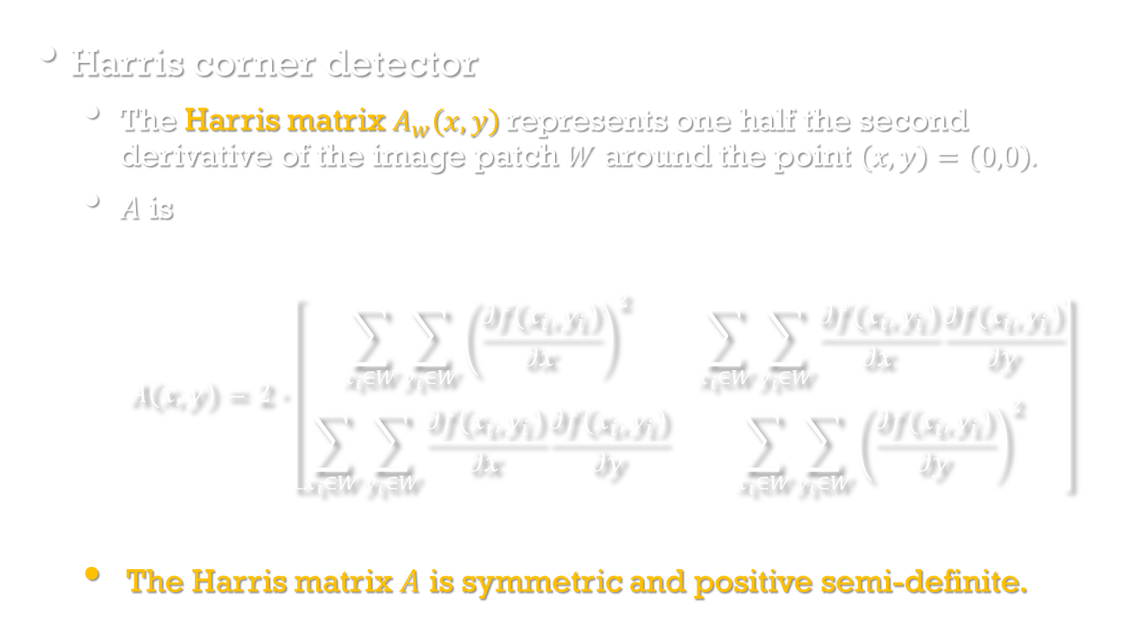
Detection of corners
Image Processing, Analysis, and Machine Vision, 4th Edition Sonka, Hlavac & Boyle
Harris corner detector
The Harris matrix $A_{w}\left(x,y\right)$ represents one half the second derivative of the image patch $W$ around the point $\left(x,y\right)=\left(0,0\right).$
$A$ is
$$A\left(x,y\right)=2∙\left[\begin{matrix}\sum_{x_{i}∈W}{\sum_{y_{i}∈W}{{\left(\frac{∂f\left(x_{i},y_{i}\right)}{∂x}\right)}^{2}}} & \sum_{x_{i}∈W}{\sum_{y_{i}∈W}{\frac{∂f\left(x_{i},y_{i}\right)}{∂x}\frac{∂f\left(x_{i},y_{i}\right)}{∂y}}} \\ \sum_{x_{i}∈W}{\sum_{y_{i}∈W}{\frac{∂f\left(x_{i},y_{i}\right)}{∂x}\frac{∂f\left(x_{i},y_{i}\right)}{∂y}}} & \sum_{x_{i}∈W}{\sum_{y_{i}∈W}{{\left(\frac{∂f\left(x_{i},y_{i}\right)}{∂y}\right)}^{2}}}\end{matrix}\right]$$
The Harris matrix $A$ is symmetric and positive semi-definite.
https://en.wikipedia.org/wiki/Positive-definite_matrix

Slide 28
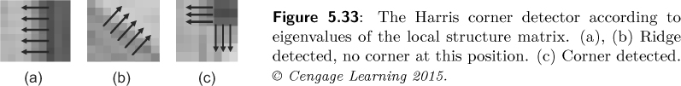
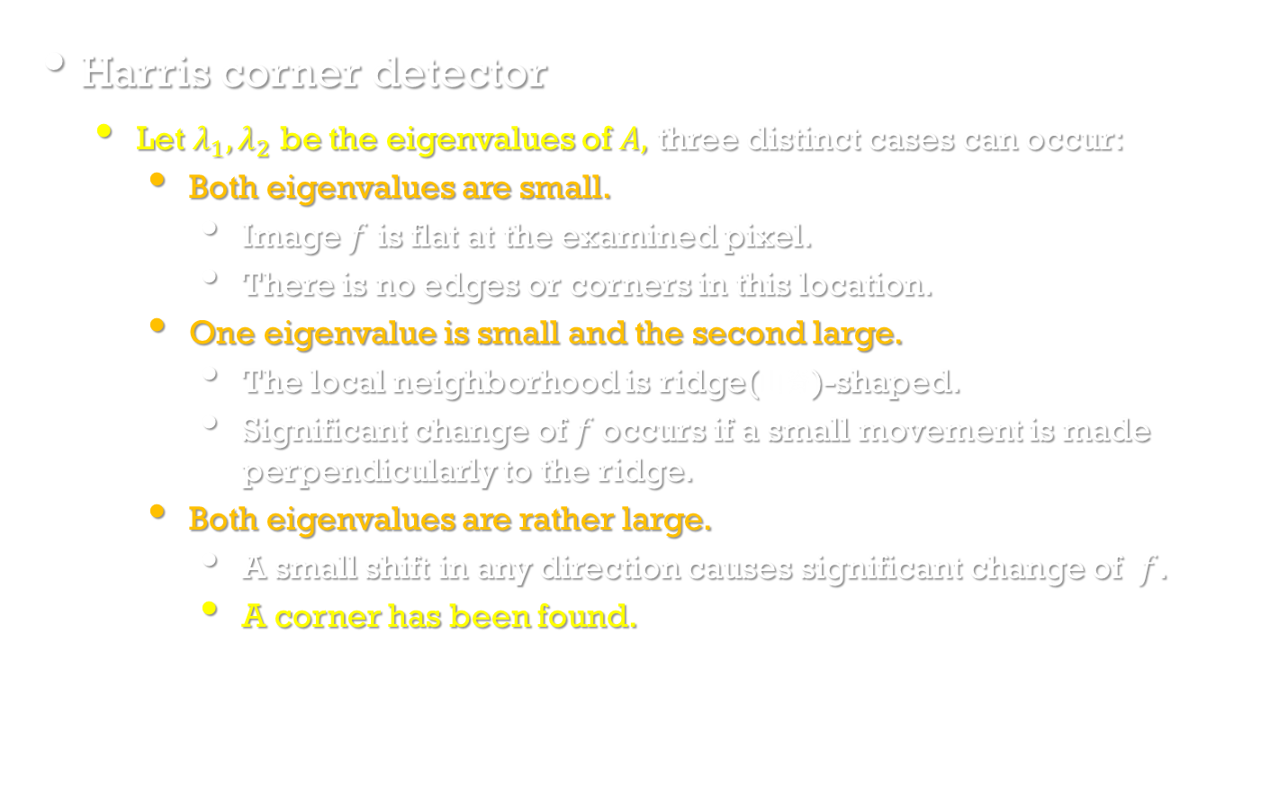
Detection of corners
Image Processing, Analysis, and Machine Vision, 4th Edition Sonka, Hlavac & Boyle
Harris corner detector
Let $λ_{1},λ_{2}$ be the eigenvalues of $A,$ three distinct cases can occur:
Both eigenvalues are small.
Image $f$ is flat at the examined pixel.
There is no edges or corners in this location.
One eigenvalue is small and the second large.
The local neighborhood is ridge(山脊)-shaped.
Significant change of $f$occurs if a small movement is made perpendicularly to the ridge.
Both eigenvalues are rather large.
A small shift in any direction causes significant change of $f$.
A corner has been found.

Slide 29
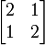
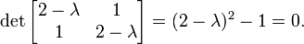
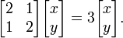
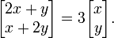
Eigenvalue and Eigenvector
Given a square matrix A, the eigenvalue can be obtained by
For example
The matrix defines a linear transformation of the real plane.
The eigenvalues of matrix A are given by
The roots of this equation are λ = 1 and λ = 3.
Considering first the eigenvalue λ = 3, we have
After matrix-multiplication
This matrix equation represents a system of two linear equations
2x + y = 3x and x + 2y = 3y.
Both the equations reduce to the single linear equation x = y.
To find an eigenvector, we are free to choose any value for x,
so by picking x=1 and setting y=x, we find the eigenvector to be

Slide 30
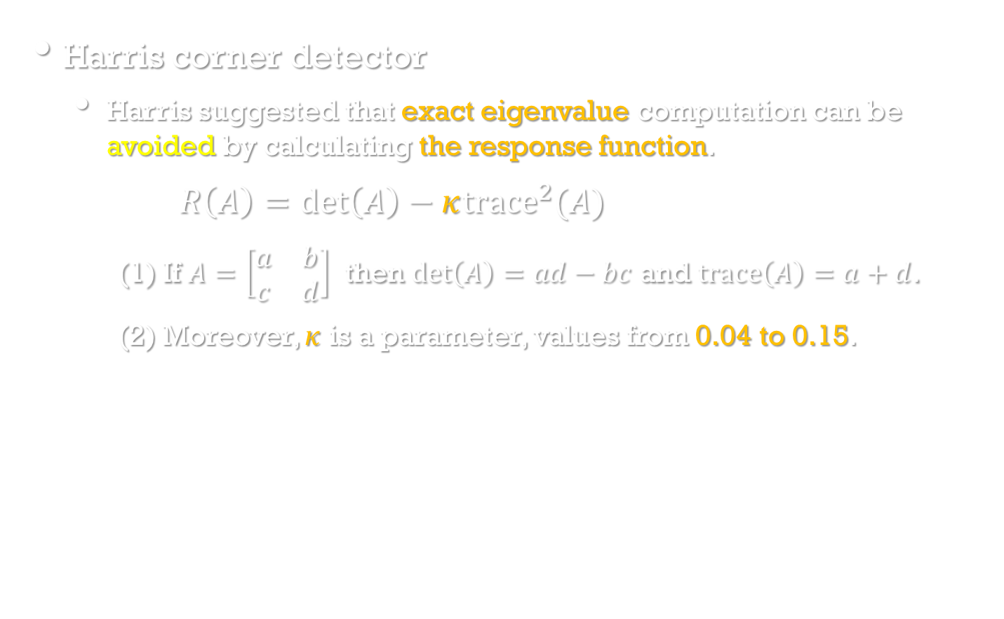
Detection of corners
Image Processing, Analysis, and Machine Vision, 4th Edition Sonka, Hlavac & Boyle
Harris corner detector
Harris suggested that exact eigenvalue computation can be avoided by calculating the response function.
$R\left(A\right)=\det\left(A\right)−κ{trace}^{2}(A)$
(1) If $A=\left[\begin{matrix}a & b \\ c & d\end{matrix}\right]$ then $\det\left(A\right)=ad−bc$ and $trace\left(A\right)=a+d$.
(2) Moreover, $κ$ is a parameter, values from 0.04 to 0.15.

Slide 31
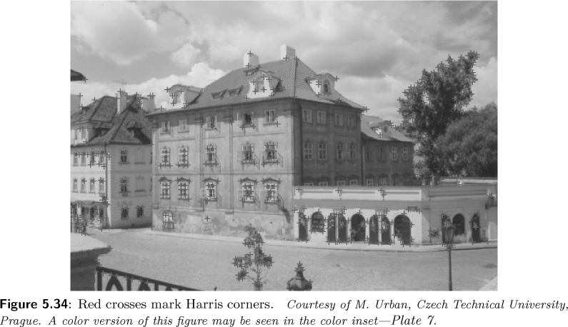
Detection of corners
Image Processing, Analysis, and Machine Vision, 4th Edition Sonka, Hlavac & Boyle
Examples of Harris corner detector

Slide 32

Harris corner detector
Image Processing, Analysis, and Machine Vision, 4th Edition Sonka, Hlavac & Boyle
Algorithm 5.5 Harris corner detector
1. Filter the image with a Gaussian.
2. Estimate intensity gradient in two perpendicular directions for each pixel, $\frac{∂f\left(x,y\right)}{∂x}$, $\frac{∂f\left(x,y\right)}{∂y}$. This is performed by twice using a 1D convolution with the kernel approximating the derivative.
3. For each pixel and a given neighborhood window:
Calculate the local structure matrix $A$.
Evaluate the response function $R(A)$.
4. Choose the best candidates for corners by selecting a threshold on the response function and perform non-maximal suppression.

Slide 33

Detection of maximally stable extremal regions
Image Processing, Analysis, and Machine Vision, 4th Edition Sonka, Hlavac & Boyle
If the image is rescaled or transformed projectively, the output of a Harris detector changes rapidly.
Maximally Stable Extremal Regions (MSERs) are an example of an image structure that can be repeatably detected not only after translations and rotations, but also after similarity and affine transforms.
Informally, MSERs can be explained by imagining all possible thresholdings of an input gray-level image $I$.
We will refer to the pixels below a threshold as ‘black’ and to those above or equal as ‘white’.
If we shown a movie of thresholded image $I_{t},$ with frame $t$ corresponding to threshold $t,$ we will see first a white image, and the last image is black.
The connected components in these frames are the set of maximal regions.

Slide 34
Maximally Stable Extremal Regions
http://vision.princeton.edu/projects/2012/SUN360/CVPR2012code/code/vlfeat-0.9.5/doc/api/mser_8h.html

Slide 35
Maximally Stable Extremal Regions
https://www.youtube.com/watch?v=b2pLUxB9Vaw

Slide 36

Detection of maximally stable extremal regions
Image Processing, Analysis, and Machine Vision, 4th Edition Sonka, Hlavac & Boyle
Maximally Stable Extremal Regions (MSERs) have the following properties.
Invariance to monotonic transformations.
If $I\left(p\right)<I\left(q\right) then M\left(I\left(p\right)\right)=I^{′}\left(p\right)<I^{′}\left(q\right)=M\left(I\left(q\right)\right)$
where $M$ is a transformation.
Invariance to adjacency preserving (continuous) transformations.
Stability, since only extremal regions whose support is virtually unchanged over a range of thresholds are selected.
Multi-scale detection. Since no smoothing is involved, both very fine and very large structure is detected.
The set of all extremal regions can be enumerated in $𝒪(n log log n)$, almost in linear time for 8 bit images.

Slide 37

Enumeration of extremal regions
Algorithm 5.6 Enumeration of extremal regions
1. Sort image pixels by intensity; this can be done efficiently by, e.g., binsort, in $𝒪(n)$ time.
2. Starting at the minimum intensity $g_{min}$, iterate upward.
3. Consider pixels of the current intensity $g$; introduce the pixel and update the connected component structure. This may be done using the efficient union-find algorithm [Sedgewick,1998].
4. If two regions marge, this is viewed as the death of the smaller component.
5. When all intensities have been processed, we have a data structure holding the area of each connected component as a function of a threshold.
If $Q_{1},…,Q_{i}$ are a sequence of nested extremal regions, so $Q_{g}⊂Q_{g+1}$, then extremal region $Q_{\hat{g}}$ is maximally stable iff $q\left(g\right)=\left|Q_{g+Δ}\backslash Q_{g−Δ}\right|/|Q_{g}|$ has a local minimum at $\hat{g}$, where $|∙|$denotes cardinality and $Δ$ is a parameter of the method.

Slide 38


Detection of maximally stable extremal regions
Image Processing, Analysis, and Machine Vision, 4th Edition Sonka, Hlavac & Boyle

Slide 39
Image restoration
Image Processing, Analysis, and Machine Vision, 4th Edition Sonka, Hlavac & Boyle
Pre-processing methods that aim to suppress degradation using knowledge about its nature are called image restoration. (影像還原;影像復原)
Most image restoration methods are based on convolution applied globally to the whole image.
Image restoration techniques can be classified as deterministic or stochastic.
Deterministic (決定論的) methods are applicable to images with little noise and a known degradation function.
Stochastic (隨機的) techniques try to find the best restoration according to a particular statistical criterion, e.g., a least-square method.

Slide 40
Image restoration
Image Processing, Analysis, and Machine Vision, 4th Edition Sonka, Hlavac & Boyle
Three typical degradations with a simple function
Relative constant speed movement of the object with respect to the camera
Wrong lens focus
Atmospheric turbulence (大氣亂流)
In most practical cases, there is insufficient knowledge about the degradation, and it must be estimated and modeled.
A priori knowledge: known in advance or obtained before restoration
For example, the parameters of a device (camera)
A posteriori knowledge: obtained by analyzing the degraded image
For example, the interest points in the image

Slide 41
An example—Object moving
http://www.robots.ox.ac.uk/~az/lectures/ia/lect3.pdf

Slide 42
An example—Wrong lens focus
http://www.robots.ox.ac.uk/~az/lectures/ia/lect3.pdf

Slide 43
An example—Atmospheric turbulence
https://www.udayton.edu/engineering/research/signal-and-image-processing-lab/research/index.php

Slide 44

Image restoration
Image Processing, Analysis, and Machine Vision, 4th Edition Sonka, Hlavac & Boyle
A degraded image $g$ can arise from the original image $f$ by
$$g\left(i,j\right)=s\left(\int{\int_{(a,b)∈𝒪}^{ }{f\left(a,b\right)h\left(a,b,i,j\right)dadb}}\right)+ν(i,j)$$
where $s$ is some non-linear function and $ν$ describes the noise.
It can be simplified by neglecting the non-linearity and assuming that the function $h$ is invariant with respect to position in the image.
$$g\left(i,j\right)=(f∗h)(i,j)+ν(i,j)$$
If the noise is not significant in this equation, the restoration equates to inverse convolution.
If noise is not negligible, then the inverse convolution is solved as an overdetermined system of linear equations.

Slide 45

Image restoration
Image Processing, Analysis, and Machine Vision, 4th Edition Sonka, Hlavac & Boyle
Degradations that are easy to restore
Since $g\left(i,j\right)=(f∗h)(i,j)$, in the Fourier domain,
$$G=HF$$
Case 1: Relative motion of camera and object
Suppose $V$ is the constant speed in the direction of the $x$ axis, $T$ be the shutter open time. The Fourier transform $H(u,v)$ of the degradation caused in time $T$ is give by [Rosenfeld and Kak, 1982]
$$H(u,v)=\frac{sin⁡(πVTu)}{πVu}$$

Slide 46


Image restoration
Image Processing, Analysis, and Machine Vision, 4th Edition Sonka, Hlavac & Boyle
Case 2: Wrong lens focus
Image smoothing caused by imperfect focus of a thin lens can be described by the function [Born and Wolf, 1969]
$$H(u,v)=\frac{J_{1}⁡(ar)}{ar}$$
where $J_{1}$ is the Bessel function of the first order, $r^{2}=u^{2}+v^{2}$, and $a$ is the displacement.
The model is not space invariant.
由Alessio Damato - own work本向量圖形使用gnuplot創作。https://commons.wikimedia.org/w/index.php?curid=365944

Slide 47

Image restoration
Image Processing, Analysis, and Machine Vision, 4th Edition Sonka, Hlavac & Boyle
Case 3: Atmospheric turbulence
Atmospheric turbulence is degradation that needs to be restored in remote sensing (遙測) and astronomy (天文學).
One mathematical model [Hufnagel and Stanley, 1964] is
$$H(u,v)=e^{−c{\left(u^{2}+v^{2}\right)}^{5/6}}$$
where $c$ is a constant that depends on the type of turbulence which is usually found experimentally.

Slide 48

Image restoration
Image Processing, Analysis, and Machine Vision, 4th Edition Sonka, Hlavac & Boyle
Inverse filtering
$$g\left(i,j\right)=(f∗h)(i,j)+ν(i,j)$$
Inverse filtering assumes that
degradation was caused by a linear function $h(i,j)$
consider the additive noise $ν$ as another source of degradation
additive noise $ν$ is independent of the signal
After applying the Fourier transform
$$G\left(u,v\right)=F\left(u,v\right)H\left(u,v\right)+N\left(u,v\right)$$
The original image $F$ (its Fourier transform to be exact)
$$F\left(u,v\right)=G\left(u,v\right)H^{−1}\left(u,v\right)−N(u,v)H^{−1}\left(u,v\right)$$

Slide 49

Image restoration
Image Processing, Analysis, and Machine Vision, 4th Edition Sonka, Hlavac & Boyle
Wiener (least mean square) filtering
Wiener filtering attempts to take account of noise properties by incorporating a priori knowledge in the image restoration formula.
Restoration by the Wiener filter gives an estimate $\hat{f}$ of the original image $f$with minimal mean square error.
$$e^{2}=ℰ\left\{{\left(f\left(i,j\right)−\hat{f}(i,j)\right)}^{2}\right\}$$
where $ℰ$ denotes the mean operator.
Denote the Fourier transform of the Wiener filter by $H_{W}$.
The estimate $\hat{F}$of the Fourier transform $F$ of the original image $f$can be obtained as
$$\hat{F}\left(u,v\right)=H_{W}\left(u,v\right)G(u,v)$$

Slide 50

Image restoration
Image Processing, Analysis, and Machine Vision, 4th Edition Sonka, Hlavac & Boyle
Wiener (least mean square) filtering
The estimate $\hat{F}$of the Fourier transform $F$ of the original image $f$can be obtained as
$$\hat{F}\left(u,v\right)=H_{W}\left(u,v\right)G\left(u,v\right)$$
$H_{W}$ is not derived here, but may be found elsewhere [Gonzalez and Woods, 1992] as
$$H_{W}\left(u,v\right)=\frac{H^{∗}(u,v)}{{|H(u,v)|}^{2}+{\left[S_{vv}\left(u,v\right)/S_{ff}(u,v)\right]}^{2}}$$
where $H$: the transform function of the degradation.
$∗$: the complex conjugate
$S_{vv}$: the spectral density of the noise
$S_{ff}$: the spectral density of the undegraded image
https://en.wikipedia.org/wiki/Spectral_density
http://homepages.inf.ed.ac.uk/rbf/CVonline/LOCAL_COPIES/VELDHUIZEN/node15.html

Slide 51


Image restoration
Image Processing, Analysis, and Machine Vision, 4th Edition Sonka, Hlavac & Boyle
An restoration example of an image that was degraded by 5 pixels motion in the direction of the $x$ axis

